Slide 1
RESIDENTIAL GARAGE ADDITION
Team Hawkeye
Team members : Alhawraa Alhosaini, Daliza Jeffrey, Garrett Chott
Technical Advisor: Jaclyn Zibrat, EIT, Hubbard Merrell

Slide 2
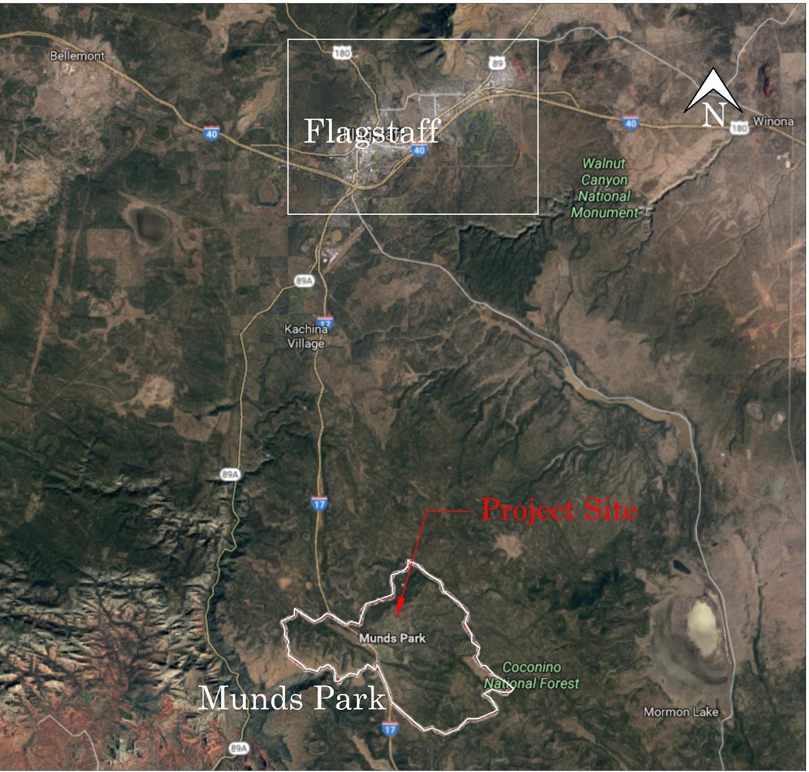
Project Background
Mark Haven’s home is located in Munds Park, Coconino County [1].
Primary concerns: Residence has no garage; Vehicles not accessible during winter
Secondary concerns: Residence is lacking space for storage or client’s photography interests
Figure 1: Location of Munds Park & Project Site
2
Notes:
(it is a residential manufactured home, approx 6,000 sq ft)
Stakeholders: Mark Haven, the contractor hired to build the garage, and the people who live in Mark Haven’s neighborhood

Slide 3
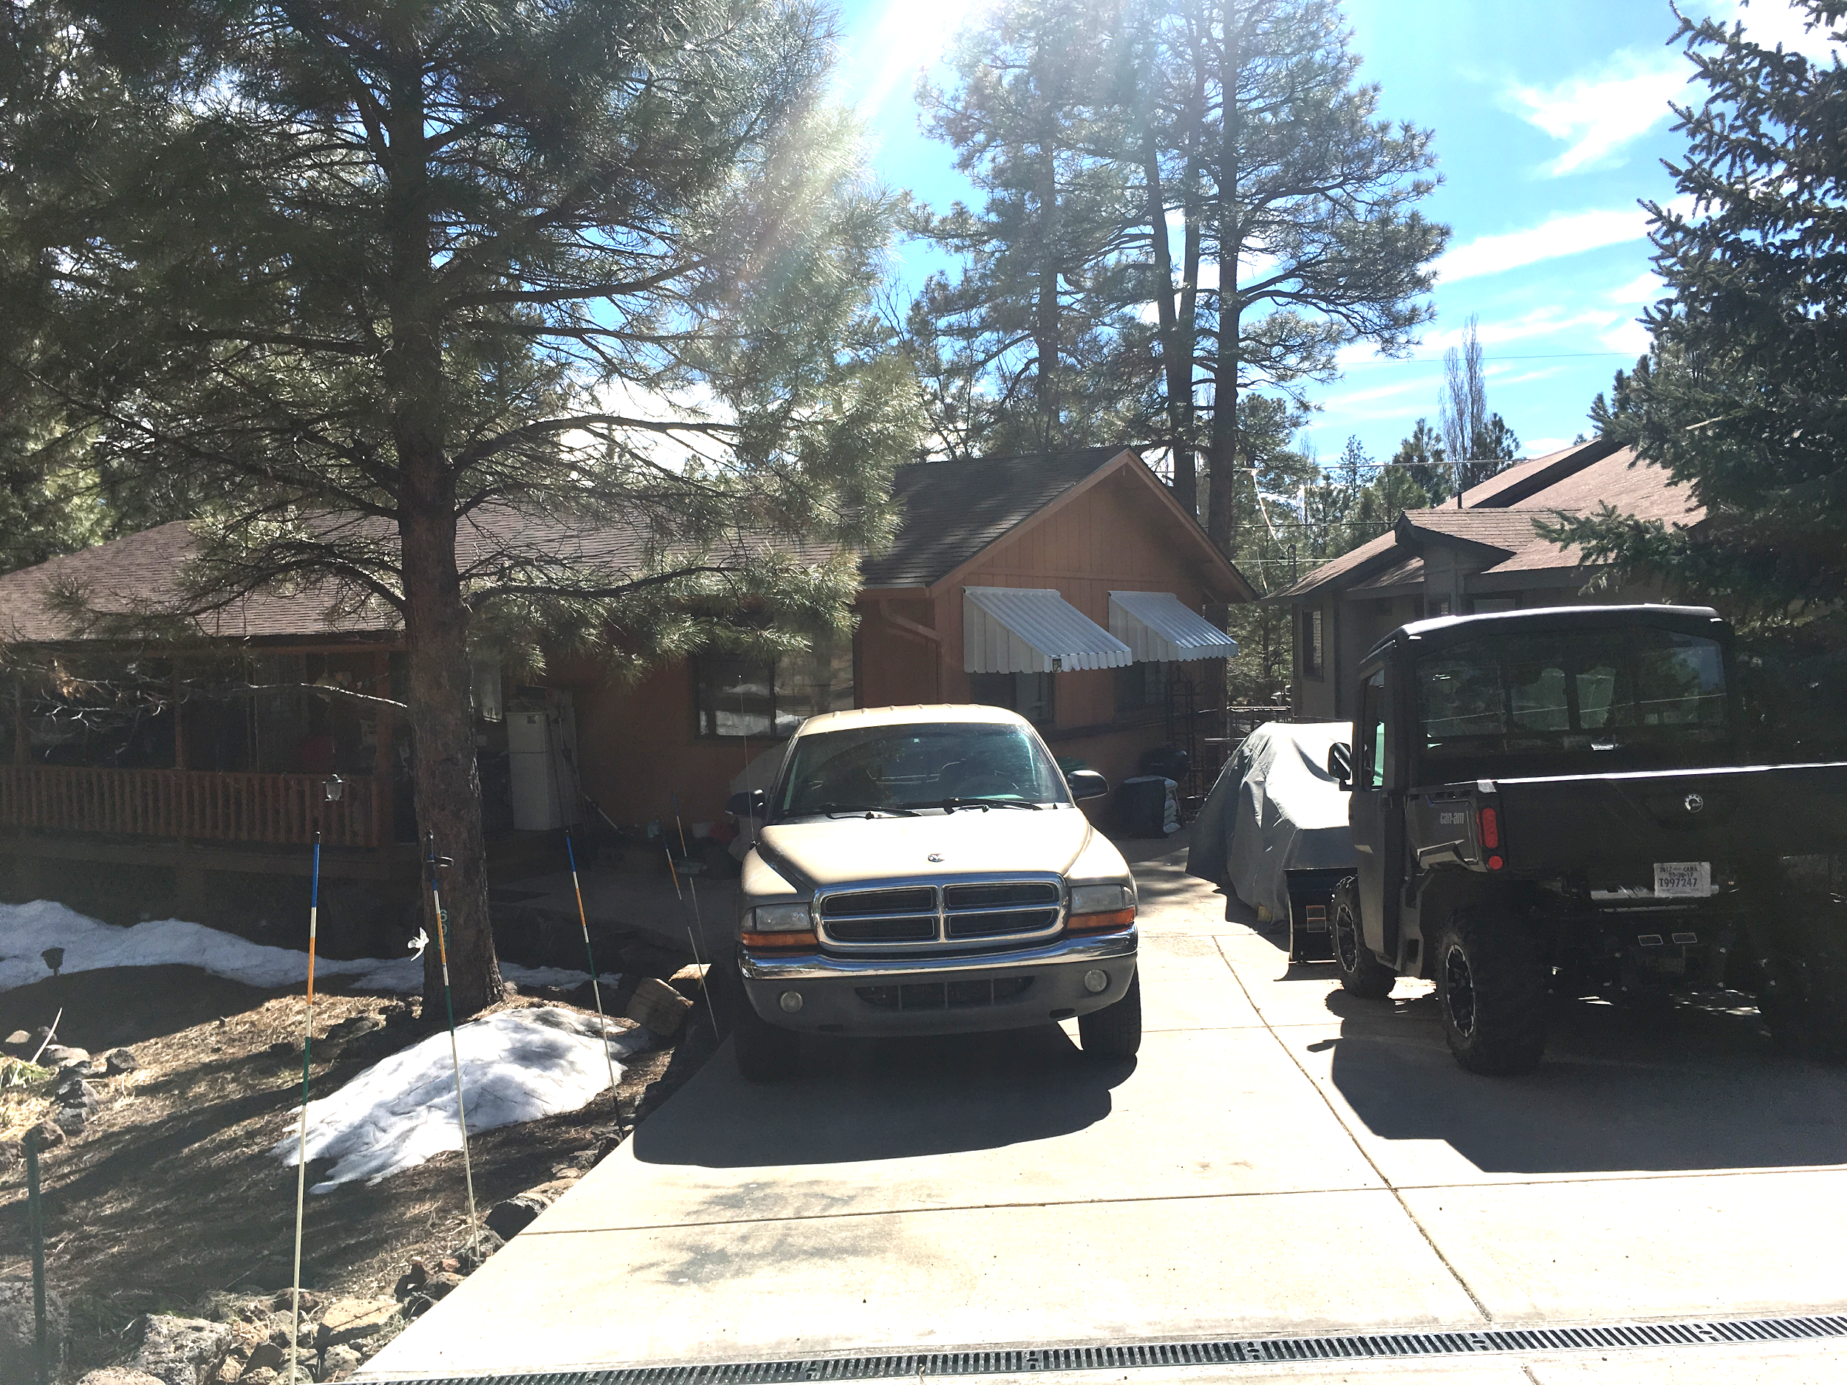
Project Understanding
Criteria
Two story, Two-Car garage or carport
Accessible during snowstorms
Must be ADA accessible
Second floor for photography studio and/or storage
Constraints
Can not alter existing landscape
15’ setback and 5’ easement leaves minimal area for design[2]
Figure 2: Mark Haven’s Residence (Front view)
3
Notes:
Setbacks on Pg 35 of Zoning Ordinance

Slide 4
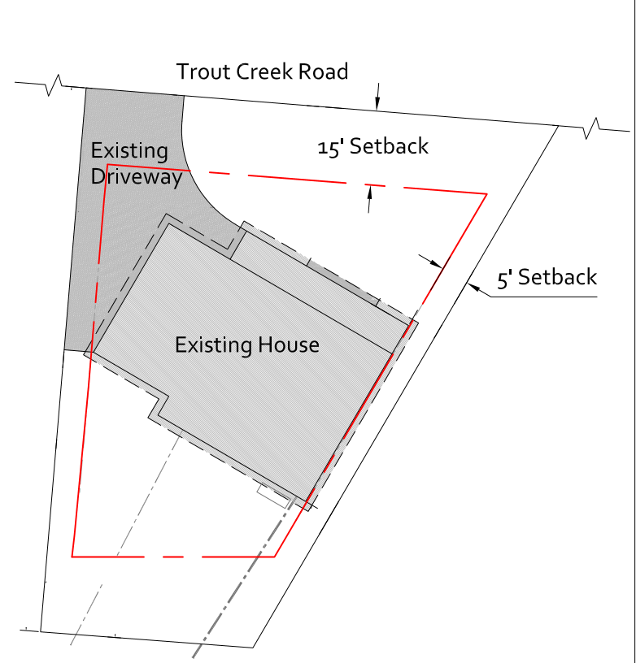
Scope of Services
Task 1.0: Surveying and Site
Analysis
Task 1.1: Control Setup [3]
Task 1.2: Surveying & Taping [4]
Task 1.3: Mapping
Task 2.0: Conceptual Design
Task 2.1: Design Concepts
Task 2.2: Code Research
Figure 3: Site plan of Haven’s lot
4

Slide 5
Scope of Services (cont.)
Task 3.0: Structural Design & Analysis
Task 3.1: Gravity Design Loads [5] Task 3.2: Lateral Design Loads [5] Task 3.3: Truss Analysis & Design Task 3.4: Joist Analysis & Design | Task 3.5: Beam Analysis & Design Task 3.6: Header Analysis & Design Task 3.7: Column Analysis & Design Task 3.8: Foundation Analysis & Design
5

Slide 6
Scope of Services (cont.)
Task 4.0: Construction Documents & Drafting Services
Task 4.1: 50% & 75% Construction Documents
Task 4.2: Final Deliverables & Report [6][7]
Task 5.0: Project Management
Task 5.1: Team Meetings
Task 5.2: Client Meetings
Exclusions
Geotechnical investigation
Mechanical systems
Electrical
Plumbing
HVAC
Fire Safety & Sprinkler System
Design Check to Existing Foundation
Submittal/Application for Building Permits
6
Notes:
Minimum requirements for a building Permit in Coconino County: Foundation Plan (footings, stem walls), Floor Framing Plan (i-joist system & framing & connectors) , Floor Plan (windows, emergency exits, etc), Electric Plan (excluded), Elevations, Roof Framing Plan (headers, load bearing beams, ceiling joists, etc), Cross sections (all dimensions), Details (for footings & and connections), Log home specs (showing all graded lumber)

Slide 7
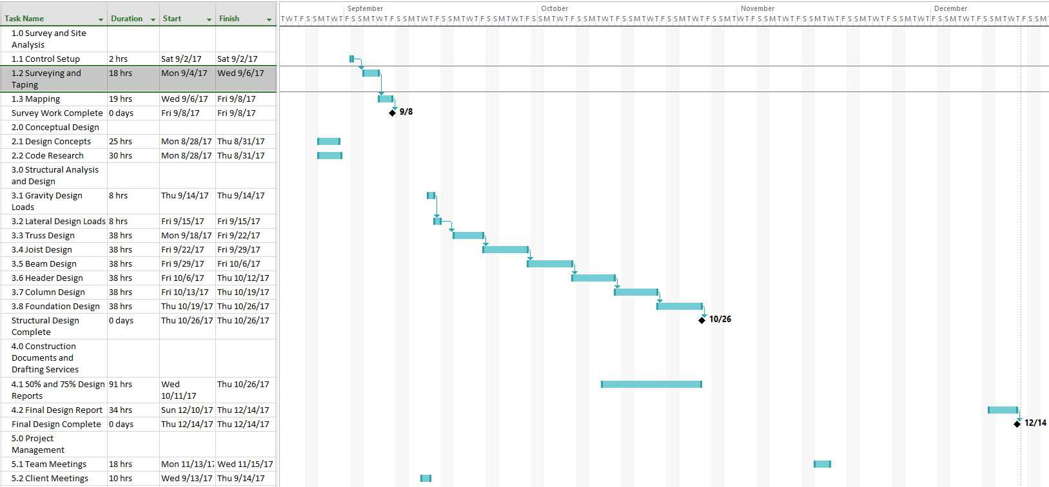
Scheduling
Figure 4: Project Gantt Chart
7

Slide 8
Staffing
Classification
Project Manager (PM)
Lead Structural Engineer (SE)
Lead Surveyor (LS)
Engineer in Training (EIT)
Drafter (DS)
Personnel Hours
 | PM | SE | LS | EIT | DS | Total Hr/ Task
Task 1.0 Survey & Site Analysis | 9 | 0 | 25 | 2 | 15 | 51
Task 2.0 Conceptual Design | 3 | 4 | 0 | 15 | 15 | 37
Task 3.0 Structural Design & Analysis | 12 | 114 | 0 | 230 | 0 | 356
Task 4.0 Construction Documents & Drafting Services | 9 | 2 | 0 | 10 | 105 | 126
Task 5.0 Project Management | 30 | 0 | 1 | 2 | 6 | 39
Total Hours per Position | 63 | 316 | 26 | 259 | 120 | 609
8

Slide 9
Cost Estimate
Staffing and Cost Estimate
 | PM (hr) | SE (hr) | LS (hr) | EIT (hr) | DS (hr) | Subtask Total Labor
Billing Rate ($/hr) | $125 | $170 | $60 | $65 | $70
Task 1.0 Survey & Site Analysis | 9 | 0 | 25 | 2 | 15 | $ 3,805.00
Task 2.0 Conceptual Design | 3 | 4 | 0 | 15 | 15 | $ 3,080.00
Task 3.0 Structural Design & Analysis | 12 | 114 | 0 | 230 | 0 | $ 35,830.00
Task 4.0 Construction Docs & Drafting Services | 9 | 2 | 0 | 10 | 105 | $ 9,465.00
Task 5.0 Project Management | 30 | 0 | 1 | 2 | 6 | $ 4,360.00
Grand Total |  |  |  |  |  | $ 56,540.00

Slide 10
References
[1] "Munds Park, Arizona," 2017. [Online]. Available: http://www.city-data.com/city/Munds-Park-Arizona.html. [Accessed 07 02 2017].
[2]C. C. Arizona, "Coconino County Zoning Ordinance," 26 07 2016. [Online]. Available: http://www.coconino.az.gov/1212/Applications-Forms-Information [Accessed 27 February 2017].
[3] "Horizontal and Vertical Control," [Online]. Available: http://www.gresurv.com/hvcontrol.html. [Accessed 20 February 2017].
[4] C. D. Ghilani and P. R. Wolf, Elementary Surveying: An Introduction to Geomatics, 13th ed., Upper Saddle River, NJ: Pearson Education Inc., 2012.
[5] C. C. Arizona, “Coconino County Building Ordinance” 26 07 2016. [Online]. Available:http://coconino.az.gov/DocumentCenter/View/12230. [Accessed 27 01 2017].
[6] Coconino County Arizona Community Development, “Residential Plan Submittal Checklist Building Division”; 26 11 2016. [Online]: Available:http://coconino.az.gov/DocumentCenter/View/8839.
[7] R. Chudley and R. Greeno, “Building Construction Handbook” Elsevier, Oxford, 2008.
9

